Slide 1

The Food Recommendation System
Team Members:
S.R Sudha Rachana 154g1a0588 Batch : B8
R.Swetha 154g1a0596 Guide : L.Suman
S.Surekha 154g1a0592 M.Tech., Assistant Professor
B.Suresh Kumar 154g1a0593
Srinivasa Ramanujan Institute of Technology
Department of Computer Science & Engineering

Slide 2
Comments
Instead of user providing ingredients, the project has to recommend appropriate food to users.
Modification in usage of algorithms.
Considering various health issues like obese or non obese.

Slide 3
Abstract
Due to diversity in food components and large number of dietary sources, it is challenging to perform real-time selection of diet patterns that must fulfil one’s nutrition needs.
The project entitled “The Food Recommendation System” recommends a list of food items and its nutritional value for the people who concern about weight issues based on BMI ranges.

Slide 4
Contents
Problem Definition
Literature Survey
Proposed System
Limitations
Planning
References

Slide 5
Problem Definition
Inadequate and inappropriate intake of food is known to cause various health issues. Due to lack of concise information about healthy diet, people have to rely on medicines instead of taking preventive measures in food intake.
The purpose of this project is to examine the Body Mass Index (BMI) and to determine the nutrition-related goals of the people.

Slide 6
Literature Survey
Jong-Hun Kim [1] proposed a system which receives the disease management condition and vital sign of the user in real-time and collects user constraints through calculating BMR.
The equation that draws the required nutrients is:
Required Nutrients = BMR + Daily Activities.

Slide 7
Cont...
Yu-Hsien [2] proposes a system that uses of SPARQL to provide personalized diet recommendations to every user. This is done using an architecture that shows relationship between different ontologies.

Slide 8
Proposed System
With The Food Recommendation System, we aim to recommend appropriate nutritional intake to the users based on their personal preferences.
The core task of the system is to determine the individual bodily nutritional requirements and the corresponding raw materials that provide those nutrients.

Slide 9
Cont...
Body mass index (BMI) is commonly used to determine overweight and obesity. It is calculated as weight in kg/m2 using the formula:
BMI = weight(kg)/height(m2)

Slide 10
Cont...
To interpret BMI, ranges have been associated with weight status as follows:
Underweight : <18.50 kg/m2
Normal range : 18.50-24.99 kg/m2
Overweight : 25.00-29.99 kg/m2
Obese : ≥30.00 kg/m2
Obese class I: 30.00-34.99 kg/m2
Obese class II: 35.00-39.99 kg/m2
Obese class III: ≥40.00 kg/m2

Slide 11
Limitations
This project only deals with the people of age above 19 years.
It does not deal with seasonal availability of food.

Slide 12
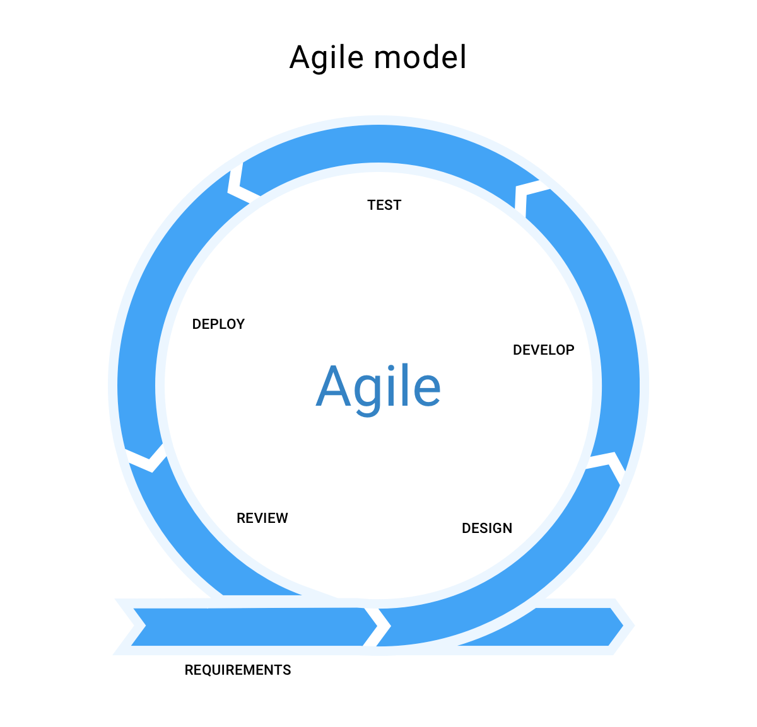
Planning model: Agile Model

Slide 13
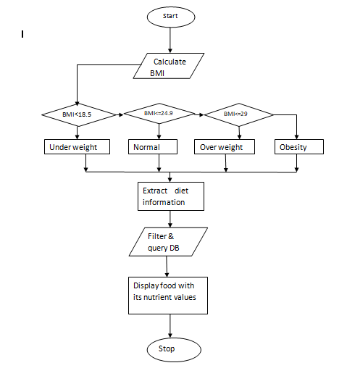
Flowchart

Slide 14
Planning
Week 1 : Information Gathering
Week 2 : Analysis and design
Week 3 : Implementation using Python
Week 4 : Testing and evaluation
Week 5 : Documentation and verification

Slide 15
References
Jong-Hun Kim, Jung-Hyun Lee, Jee-Song Park, Design of Diet Recommendation System for Healthcare Service Based on User Information‖, 2009 Fourth International Conference on Computer Sciences and Information Technology.
Yu-Hsien Ting, Qiangfu Zhao, Rung-Ching Chen, Dietary Recommendation Based on Recipe Ontology‖, Awareness Science and Technology (iCAST), 2014 IEEE 6th International Conference on 29th to 31st Oct. 2014

Slide 16
Thank you
Queries
?

